Slide 1

Cafe billing management system
Done by:
Dakshina prasath. M
Ra2311026010053,ac-1 cse-aiml

Slide 2
Abstract:
The "Cafe Billing System" is a comprehensive application developed in Python using the Tkinter library for graphical user interface design. The system aims to automate the billing process in a cafe, providing a user-friendly interface for both customers and cafe staff.
Objective:
The primary objective of the project is to create an efficient and user-friendly billing system for cafes that simplifies the process of taking orders, calculating bills, and maintaining order history. The objectives collectively aim to create a Cafe Billing System that not only meets the immediate needs of efficient order processing and billing but also provides a foundation for continuous improvement and adaptation to changing technological and business requirements.

Slide 3
Features: User Authentication: • The system includes a login mechanism to ensure only authorized personnel can access the application. • Username and password authentication are implemented to secure access. Order Management: • The application allows cafe staff to input customer orders for various menu items such as French Fries, Lunch, Burger, Pizza, Cheese Burger, and Drinks. • Real-time calculation of the total cost of the order, including tax and service charges. Bill Generation: • The system generates a detailed bill for each order, including itemized pricing and a breakdown of charges. • The bill can be displayed on the screen, printed, and saved as a QR code for quick access. Order History: • The application maintains a record of each order, including the order number, date, time, and total amount. • Users can view the order history to track past transactions. QR Code Generation: •A QR code is generated for each bill, providing a convenient way for customers to access their bill details. Price List: •The system includes a price list feature to display the cost of each menu item. Data Persistence: • Saved orders and order history are stored for future reference.

Slide 4
Technologies Used:
Programming Language: Python
GUI Library: Tkinter
External Libraries: qrcode, Pillow (PIL)
Generating QR codes: QRCode
To store data persistently: File handling

Slide 5
Challenges Faced
Integrating QR code generation.
Handling exceptions and errors.
Designing a user-friendly interface.

Slide 6
Future Enhancements:
Database Integration:
Online Ordering and Payment:
User Profiles and Permissions:
Enhanced Reporting:

Slide 7
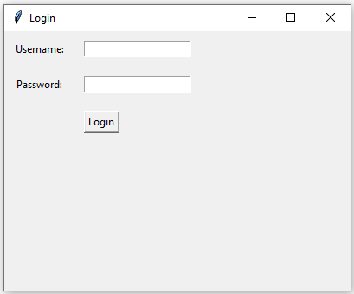
Output :
First the login page will ask the user to enter the username and password, after entering it will proceed to the billing window.

Slide 8
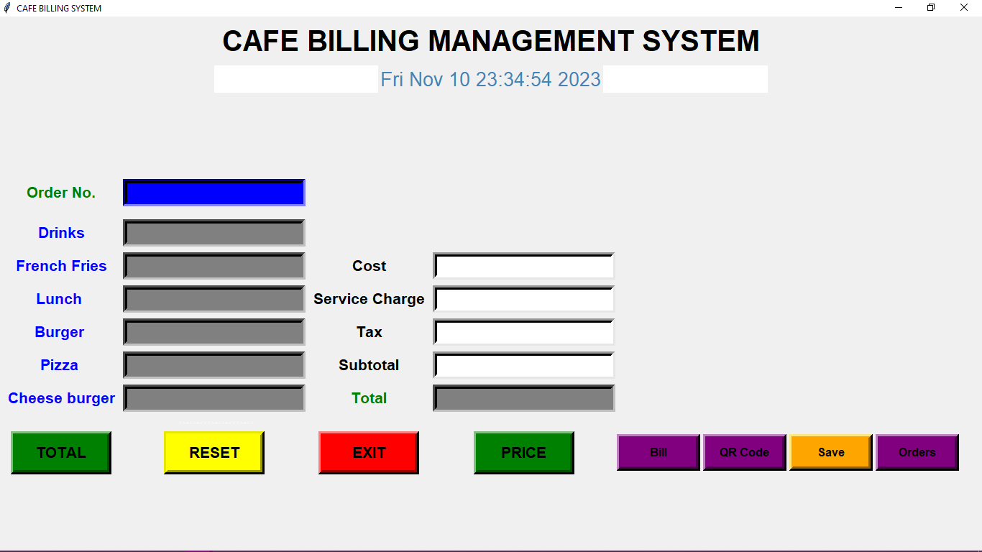
In the billing window we can enter the billing details to proceed.

Slide 9
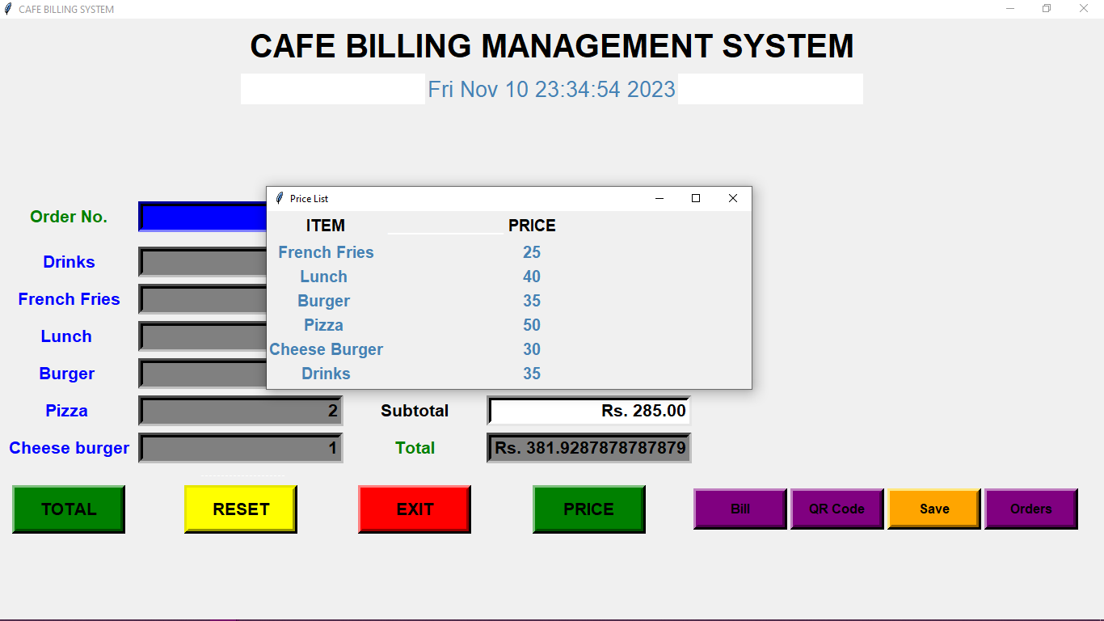
By clicking on the Price button we can see the price of all the items.

Slide 10
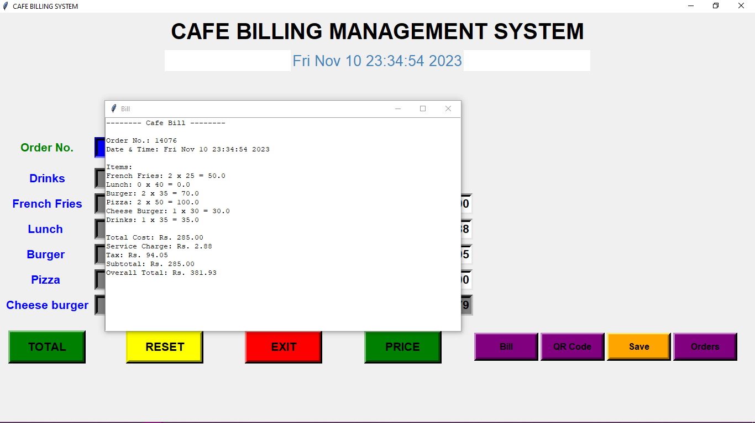
By clicking on the button we can this window which shows the actual bill.

Slide 11
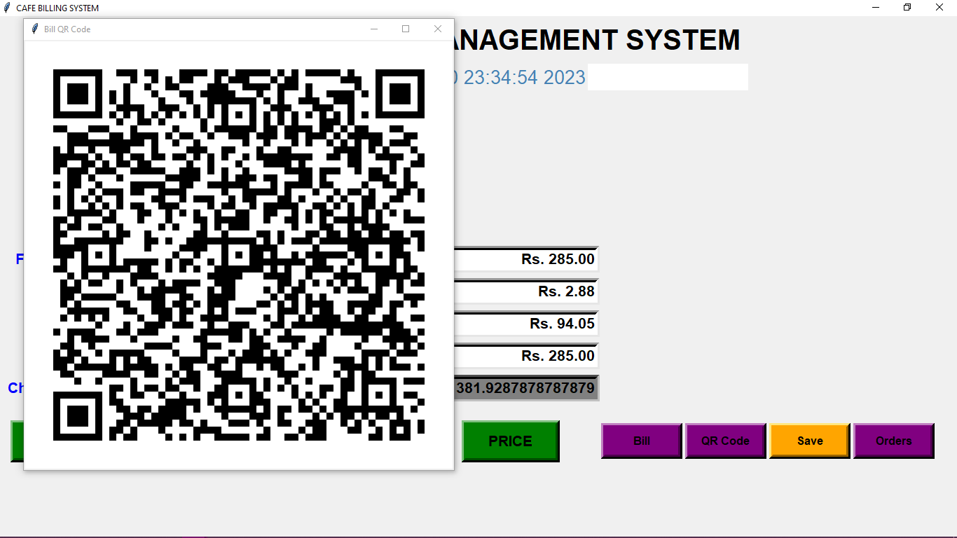
If we click on the QR Code button it will display a QR code through which we can get the billing details.

Slide 12
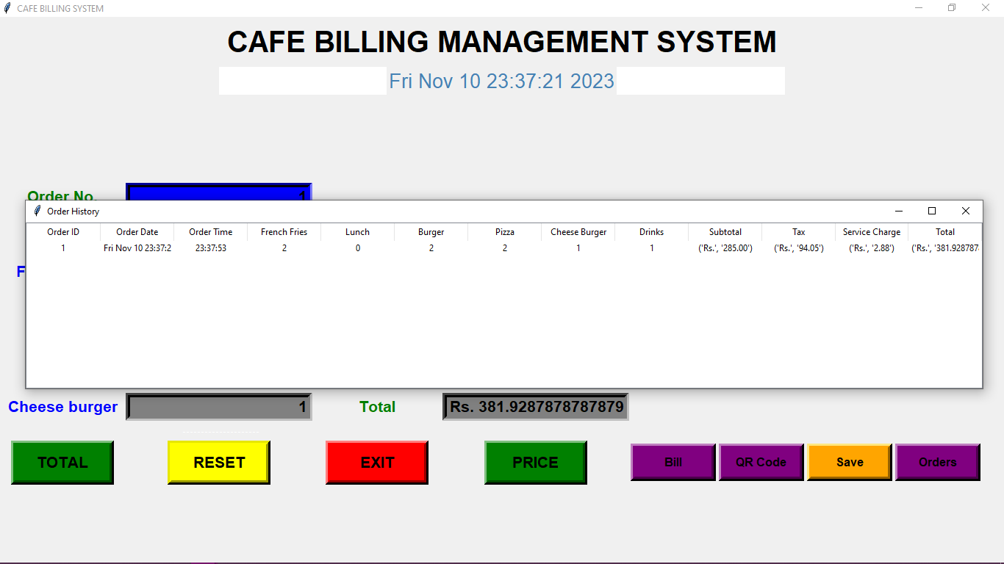
If we click on the Orders button after saving the order, this window will be displayed which has the database of the order details.

Slide 13
Conclusion:
The Cafe Billing System project demonstrates the successful integration of various features to create an efficient and user-friendly application. The implementation of security measures, intuitive order management, and advanced features like QR code generation contribute to a robust system that can benefit cafes in their daily operations.

Slide 14
References:
Tkinter Documentation:
qrcode Documentation
Pillow (PIL) Documentation

Slide 15
THANK YOU

